Slide 1

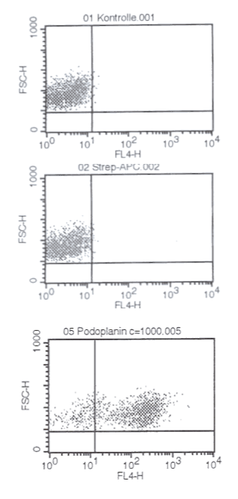
ReliaTech GmbH
Mouse anti-human Podoplanin
(Cat #101-MBi40)
Fig. 1: FACS analysis with primary human dermal lymphatic endothelial cells (HDLEC) using a Biotin-conjugated mouse anti-human Podoplanin antibody.
http://www.reliatech.de / orders@reliatech.de

